Slide 1
EF-EP-012
EPIC: Administration of the eApp
Functionalities for the product owner SF China

Slide 2
EF-EP-012: Administration of the eApp
Story ID: EP12-S001-JZ:
As a Easy Finance APP admin, I want to have an admin portal, so that I can do configuration and monitoring there.
Story ID: EP12-S002-JZ:
As a Easy Finance APP admin, I want to be able to stop usage of the App in case of emergency, so no application can be submitted from eApplication.
Story ID: EP12-S003-JZ:
As a Easy Finance APP admin, I want to be able to search for pending applications, so that I can find the respective information.
Story ID: EP12-S004-JZ:
As a Easy Finance APP admin, I want to export report, so that I can use the report for certain purpose.
Story ID: EP12-S005-JZ:
As a Easy Finance APP admin, I want to have app usage reports for statistics, so that I can analyze user behavior and improve the functionalities.
Story ID: EP12-S006-JZ:
As a Easy Finance APP admin, I want the functionalities of eApp (like eAuthentication) to be re-usable, so that I can re-use the functionalities for other use cases ( e.g. for a online customer journey (web)).
Story ID: EP12-S006-JZ:
As a Easy Finance APP admin, I want to manage masterdata in eApp, so that eApp can show correct information to customer

Slide 3
Story ID: EP12-S001-JZ:
Business
As a admin, I want to have an admin portal, so that I can do configuration and monitoring there
Assumptions:
There are admins to maintain eApp
Features and reports are updated online in real time
Pre-Conditions:
None
Acceptance Criteria:
The admin portal should be a separate site from DFE
There should be access control on this portal
The CI should comply to BMW standard
IT

Slide 4

Story ID: ES-S000
Mockups:
BMW
Admin@bmw.com
Requests
Search
Reports
No. | BO | ApplicationNo/ContractNo | Status | …
1 | 张三 | CN123321123456 | Closed
2 | 李四 | A1233456324 | Processing
3 | 王五 | CN123332132222 | Approved
… | … | … | … | …
Configure

Slide 5
Story ID: EP12-S002-JZ:
Business
As a admin, I want to be able to stop usage of the App in case of emergency, so no application can be submitted from eApplication
Assumptions:
Users use eApp to apply loan
Pre-Conditions:
The application from app shall be freeze due to certain reasons
There should be an admin portal to configure all admin features
Acceptance Criteria:
After stop from admin portal, all applications from eApp are not allowed to submit
There should be a end date and description of this emergency stop
There is a notification for user, to describe the reason of stopping service
IT
Compliance

Slide 6
Story ID: ES-S000
Mockups:
BMW
Admin@bmw.com
Requests
Emergency Stop
Reports
Configure

Slide 7
Story ID: EP12-S003-JZ:
Business
As a admin, I want to be able to search for applications, so that I can find the respective information.
Assumptions:
Admin needs to track application status
Admin needs to find specific application(s) among all applications
Pre-Conditions:
There should be a page in admin portal to track all applications
Acceptance Criteria:
The search should have multiple dimensions, like date, keyword, customer name, etc.
IT

Slide 8
Story ID: ES-S000
Mockups:
BMW
Admin@bmw.com
Requests
Search
Reports
No. | BO | ApplicationNo/ContractNo | Status | …
1 | 张三 | CN123321123456 | Closed
2 | 李四 | A1233456324 | Processing
3 | 王五 | CN123332132222 | Approved
… | … | … | … | …
Configure

Slide 9
Story ID: EP12-S004-JZ:
Business
As a admin, I want to export report, so that I can use the report for certain purpose
Assumptions:
There are admins to maintain eApp
Admin needs a report from portal
Pre-Conditions:
Admin portal stores all admin actions in log
Admin portal tracks all applications
Acceptance Criteria:
Admin actions can be export as a report
Search results can be export as a report
The report format should be pdf/excel
IT
Security

Slide 10
Story ID: ES-S000
Mockups:
BMW
Admin@bmw.com
Requests
Search
Reports
No. | BO | ApplicationNo/ContractNo | Status | …
1 | 张三 | CN123321123456 | Closed
2 | 李四 | A1233456324 | Processing
3 | 王五 | CN123332132222 | Approved
… | … | … | … | …
Configure
Export as Excel

Slide 11
Story ID: EP12-S005-JZ:
Business
As a Easy Finance APP admin, I want to have app usage reports for statistics, so that I can analyze user behavior and improve the functionalities.
Assumptions:
There are admins to maintain eApp
Admin needs to analyze the usage of eApp
Pre-Conditions:
Analysis plugins are allowed in BMW app
Analysis policy is agreed by BMW
Acceptance Criteria:
The analysis report should monitor the usage of the eApp in general, like user numbers, return rate, location, OS, etc.
The analysis report should monitor the usage in app, like user actions, login numbers, buttons clicked, etc.
IT
Compliance

Slide 12
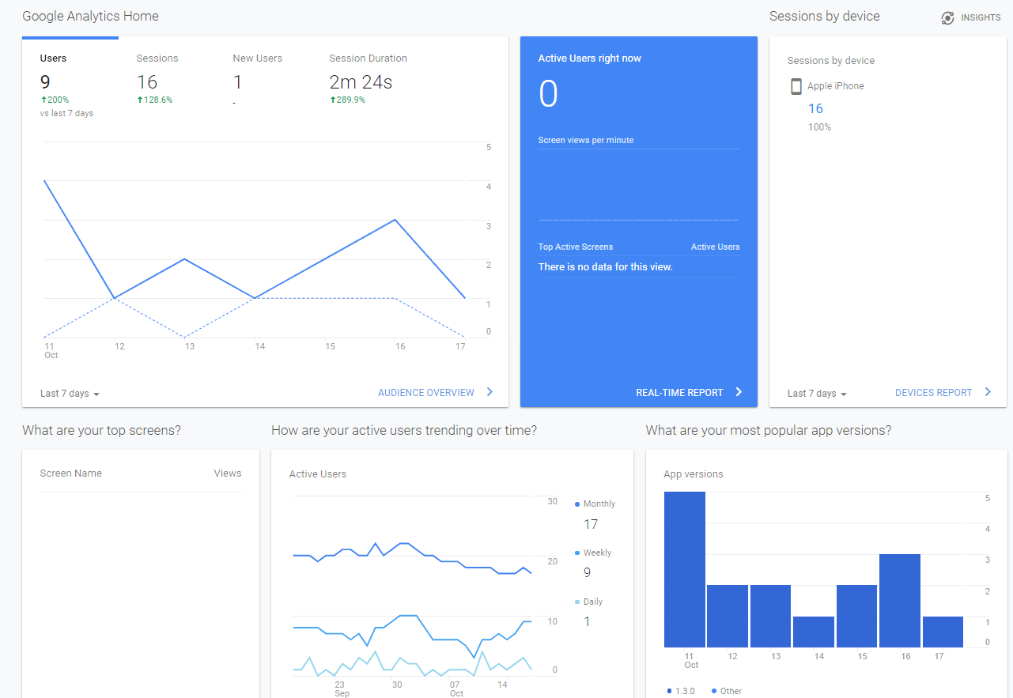
Story ID: ES-S000
Mockups:
BMW
Admin@bmw.com
Requests
Reports
Configure
Export

Slide 13
Story ID: EP12-S006-JZ:
Business
As a admin, I want the functionalities of eApp (like eAuthentication) to be re-usable, so that I can re-use the functionalities for other use cases ( e.g. for a online customer journey (web)).
Assumptions:
There will be different app/system having same purpose
Pre-Conditions:
All reusable features are pre-defined
Reusable features are not specify for mobile
Reusable features are not specify for China
Acceptance Criteria:
The reusable feature logics are build in backend service
The reusable features shall use API/Web Service to have flexibility of configurable
The APIs used in eApp shall be configurable in admin portal, to switch to other locations (TBD)
IT

Slide 14
Story ID: EP12-S007-JZ:
Business
As a admin, I want the functionalities of eApp (like eAuthentication) to be re-usable, so that I can re-use the functionalities for other use cases ( e.g. for a online customer journey (web)).
Assumptions:
Masterdata source is ready
New vehicle/product updated in masterdata source
Admin needs to manually mapping data from masterdata source to eApp database
Pre-Conditions:
N/A
Acceptance Criteria:
The data mapping can be done in portal
Admin can add/edit/remove data mapping in portal
Admin can define rules to do batch mapping
IT

